Slide 1




Slide 2
Overview
01
02
03
04
05
Project introduction &Project background
Story board &Framework&Requirements for the concept
Futher work
Hi-Fi Prototype
User test
Introduce the content, purpose, objectives and target groups of the project
Clarify the user's usage process and the Sharing personal data framework
Display different interfaces of the website
Think-alouds and SUS to get user usage data
Iteration & Formal Evaluation&Reflective

Slide 3
Background and Research
01

Slide 4
Background：The impact of the covid-19 epidemic has forced many students to accept the online education model, and this unpracticed online teaching model has put a lot of pressure on the quality of teaching.
Through research and interviews, it was identified that the main difficulties of users were focused on：
Bad learning environment
Lack of discipline and reduced concentration
Loss of school socialization
Inability to ask tutor questions in a timely manner

Slide 5
we propose to achieve a learning progress sharing platform to improve the quality of online education by encouraging interaction between students
Project aims：help students improve the quality of learning and maintain their enthusiasm for learning
Main function
Information notification
view course content
assessment reminder
Online discussion
social part:personal information,chat
study group view
Progress sharing
share study notes

Slide 6
Requirements for the concept
Problem statement
Possible solution: add social function board, share class notes, group communication interface.
What is this platform for?
Develop a shared learning platform that is used primarily through a website. To improve the learning experience of distance education users. Improve learning efficiency, increase socialization on campus and share their learning process.
Interaction models:
click button，typing information，pull up and down the page，search，browse
Key interface metaphors：
usage flow is similar to the traditional interface，icons
Interaction paradigm：
Ubiquitous Computing

Slide 7
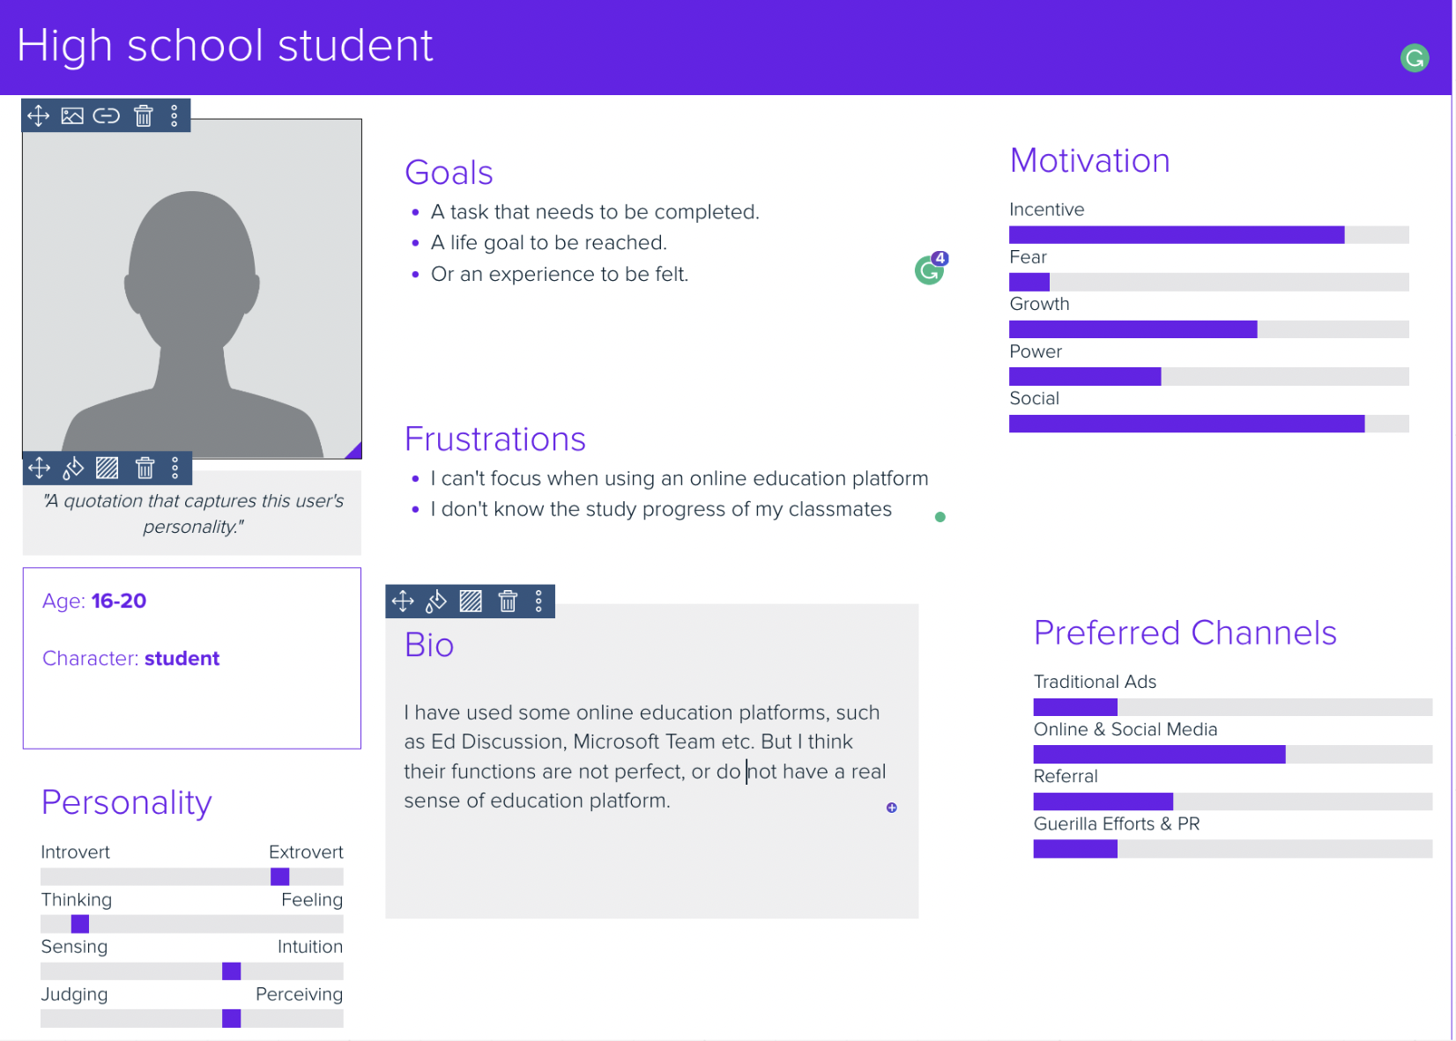
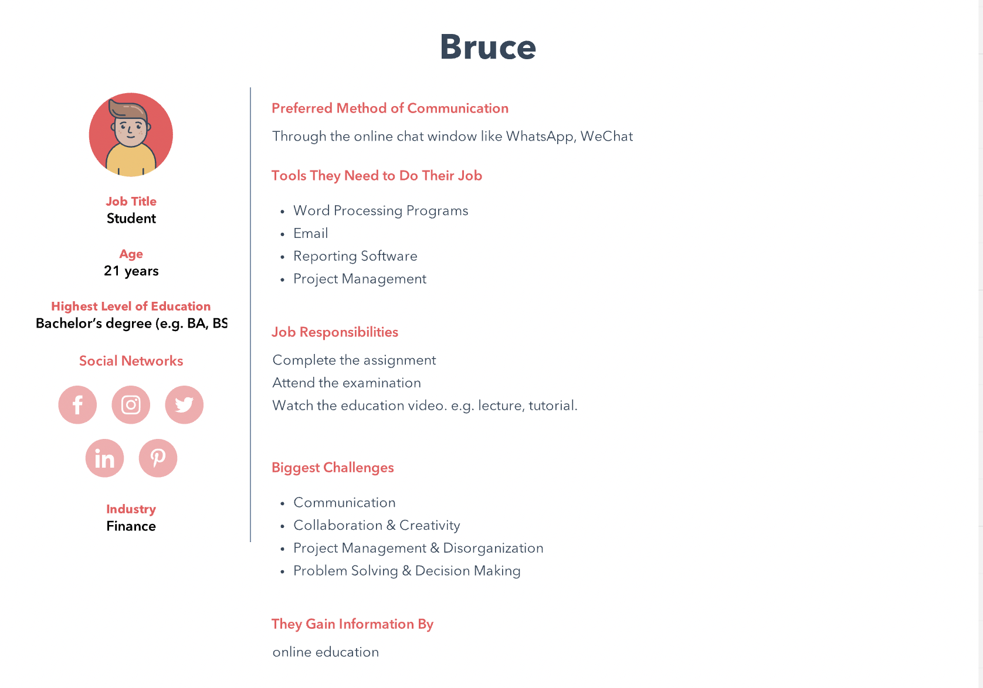
Target groups：16-25 years old students
Persona：

Slide 8
Framework and Story board
02

Slide 9
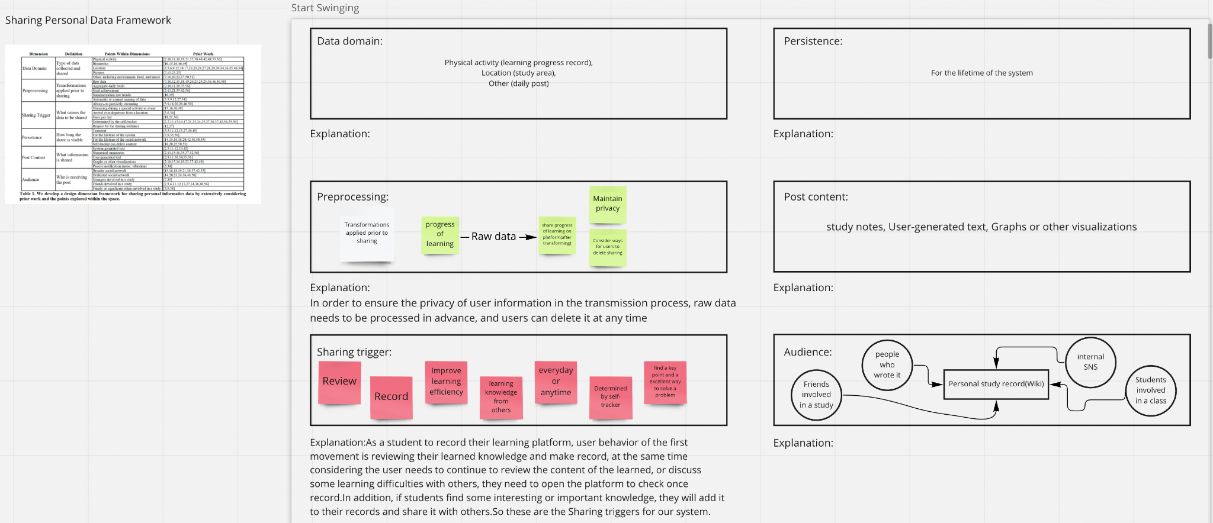
Framework-Sharing Personal Data Framework

Slide 10
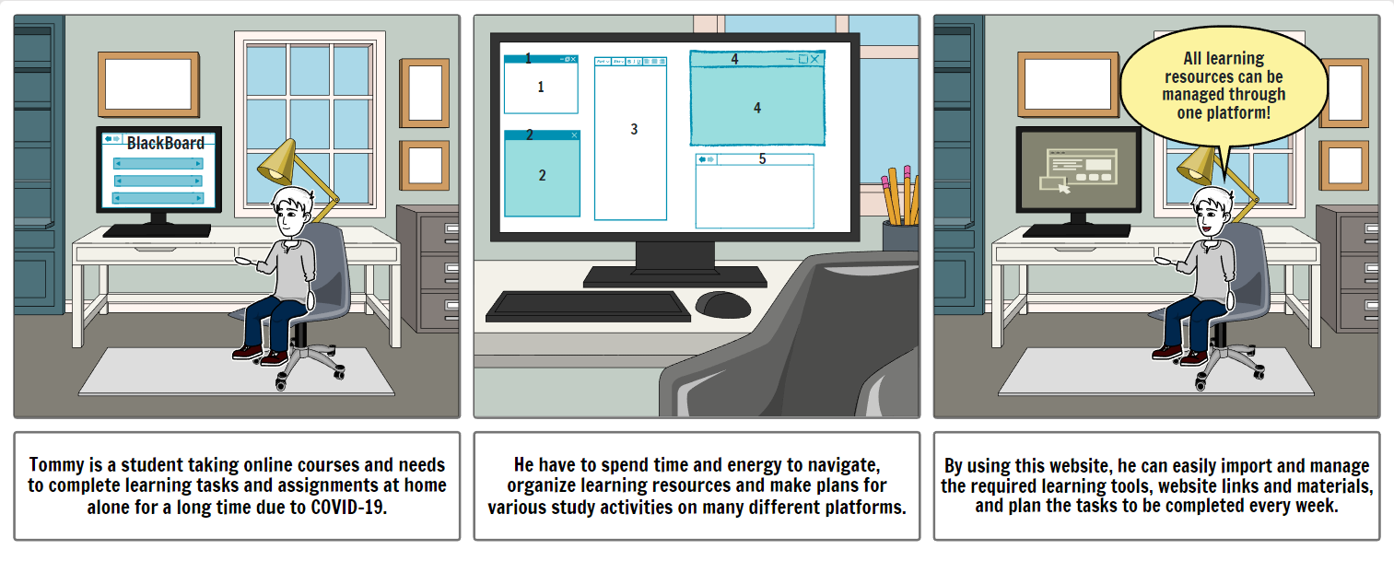
Story Board

Slide 11
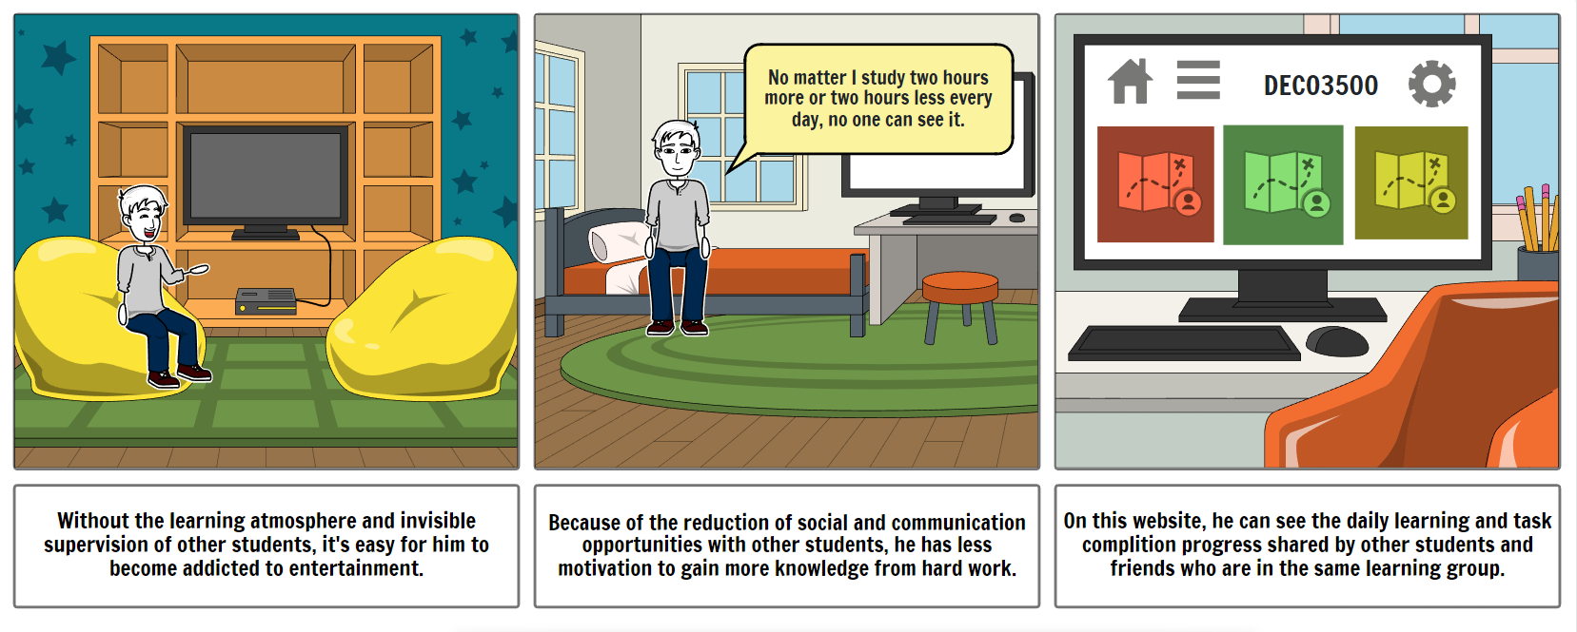
Story Board

Slide 12
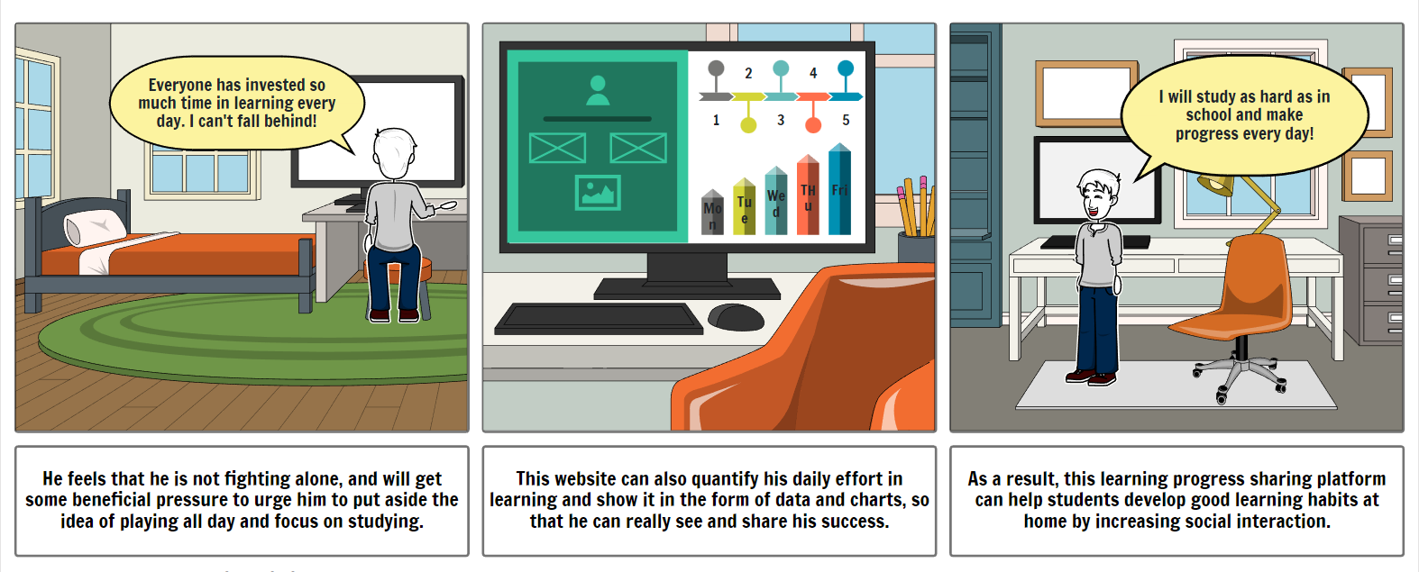
Story Board

Slide 13
Hi-Fi Prototype
03

Slide 14
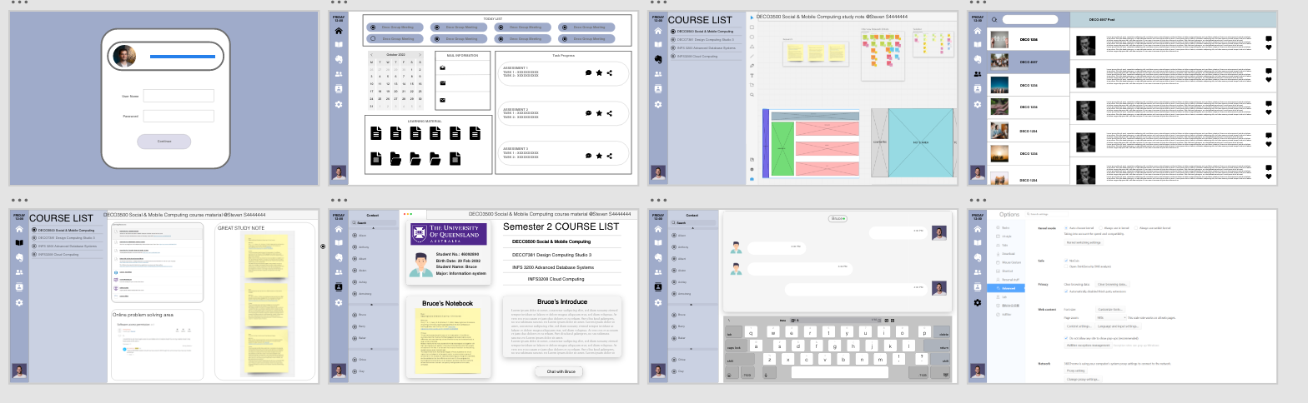
Hi-Fi Prototype

Slide 15
User Test
04

Slide 16
USER TEST - SUS
user task:
1. Ask the user to enter the note page.
2. Ask the user to find the group page and view the group task.
3. Ask users to read and understand the content on the main screen.
4. Ask users to find the social interface and see other people's profiles.
5. Ask the user to enter the course content interface and view others' study notes.
6. Users are required to enter the course content interface through the main interface.
7. Ask users to view daily tasks.

Slide 17
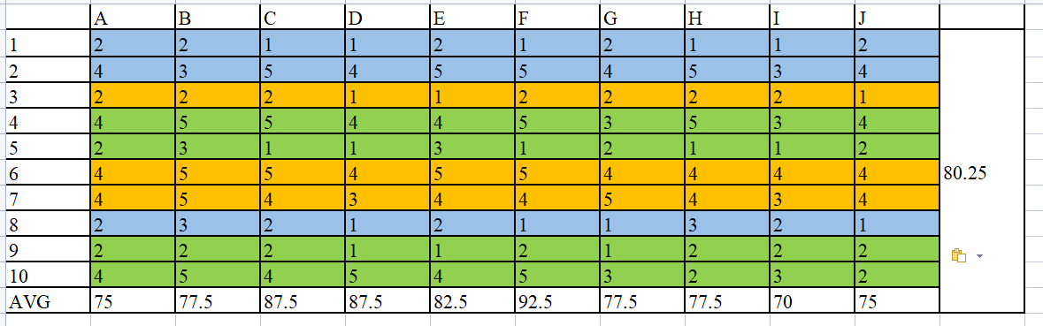
USER TEST - SUS
Result:

Slide 18
USER TEST - SUS
SUS result:
our final score ranges from 2.75 to 4.0, which is a high score.
our lowest score was obtained in Question 3, which is about the efficiency of use, which indicates that our software is less efficient to use.
The overall score is 80.25, which is a B grade score.
Drawback of SUS result:
From the point of view of the test session, the less time the user has to ask questions or think while completing the given task, the higher the score the user will give in the subsequent SUS session.
The user's familiarity affects the SUS test results and makes it easier for the prototype to achieve a high score.

Slide 19
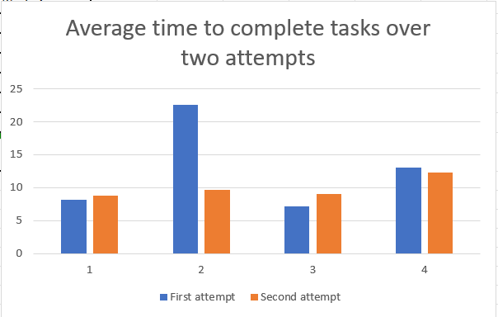
TIME ON TASK
Most of the people who took the test showed a huge improvement in the average speed of short-term memory in task 2, which also shows that our prototype needs clearer folder names or demarcation marks.

Slide 20
THINK ALOUD
1.The background of the login page is relatively simple, and there is not enough success prompt or not obvious after the login is successful.
2.Added the menu pull-up function on the catalog page of learning subjects, allowing users to increase the size of the learning content section when there is no need to select subjects.
3.The documents of different subjects are divided or marked with clearer colors, which is convenient for users to quickly find information.

Slide 21
Futher work
05

Slide 22
Futher Work
Iteration & Formal Evaluation
Make changes to the interface based on user feedback
Final Prototype
Usability assessment
Ensure that every interface is smooth to use
Reflect to gain experience
Reflective process and flow

